Slide 1

Customer Shopping Behavior Analysis
Uncovering insights from 3,900 customer transactions to guide strategic business decisions through data-driven analysis of spending patterns, customer segments, and product preferences.

Slide 2
Dataset Overview
3,900
18
$59.76
3.75
Total Purchases
Data Points
Avg Purchase
Avg Rating
Transactions analyzed across all categories
Features tracking demographics and behavior
Mean transaction value across all customers
Customer satisfaction score
Customer Demographics
Shopping Behavior
Age, Gender, Location
Purchase history and frequency
Subscription Status
Discount and promo usage
Review ratings and shipping preferences

Slide 3

Data Preparation & Analysis
01
Data Loading & Exploration
Imported dataset using pandas, examined structure with df.info() and summary statistics
02
Data Cleaning
Handled 37 missing Review Rating values using median imputation by product category
03
Feature Engineering
Created age_group bins and purchase_frequency_days columns for deeper analysis
04
Database Integration
Connected to PostgreSQL and loaded cleaned data for SQL-based business analysis

Slide 4
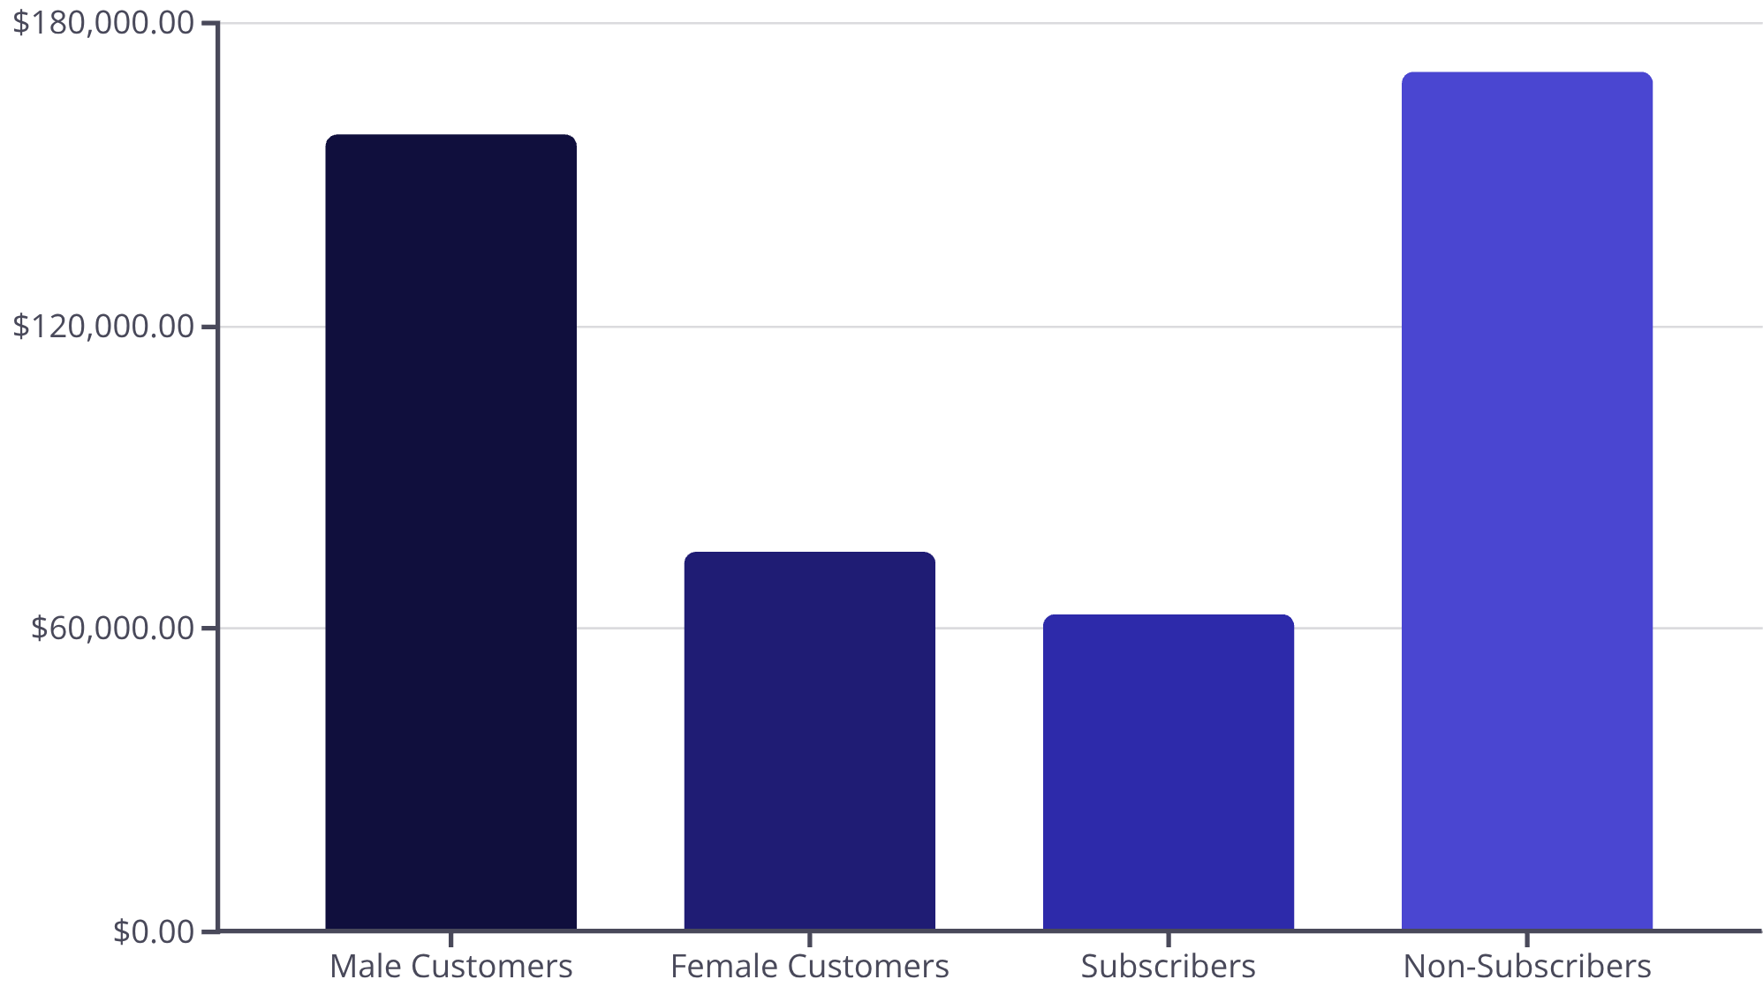
Revenue Insights
Key Findings
Male customers generate 2.1x more revenue than female customers. Non-subscribers contribute 73% of total revenue despite similar average spend ($59.87 vs $59.49).

Slide 5

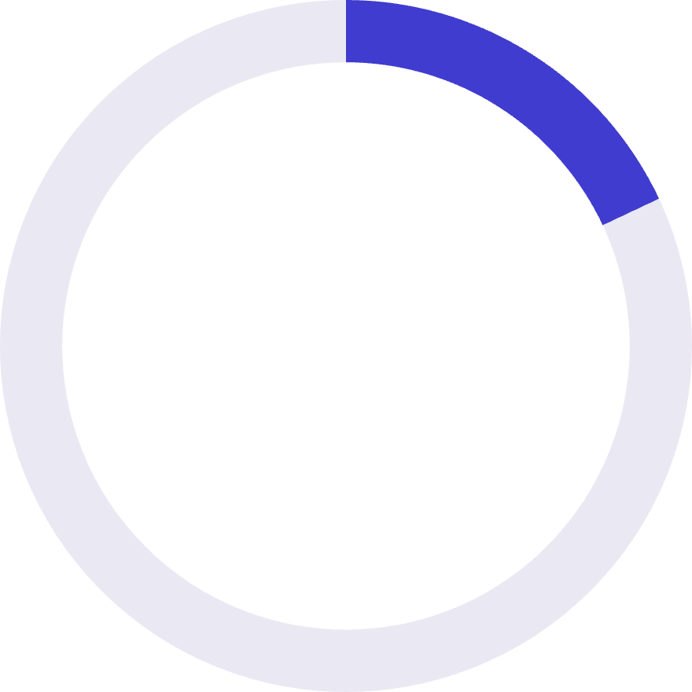

Customer Segmentation Analysis
80%
18%
2%
Loyal Customers
Returning
New Customers
3,116 customers with consistent purchase history
701 customers showing repeat behavior
83 first-time purchasers
958 repeat buyers (>5 purchases) have subscriptions, while 2,518 do not—revealing significant untapped subscription potential among loyal customers.

Slide 6
Product Performance
Top-Rated Products
Discount-Dependent Items
Gloves (3.86 rating)
Hat (50% discount rate)
Sandals (3.84 rating)
Sneakers (49.66%)
Boots (3.82 rating)
Coat (49.07%)
Hat (3.80 rating)
Sweater (48.17%)
Skirt (3.78 rating)
Pants (47.37%)
Clothing Leaders
Accessories
Footwear
Blouse and Pants tied at 171 orders each
Jewelry leads with 171 orders
Sandals top category with 160 orders

Slide 7

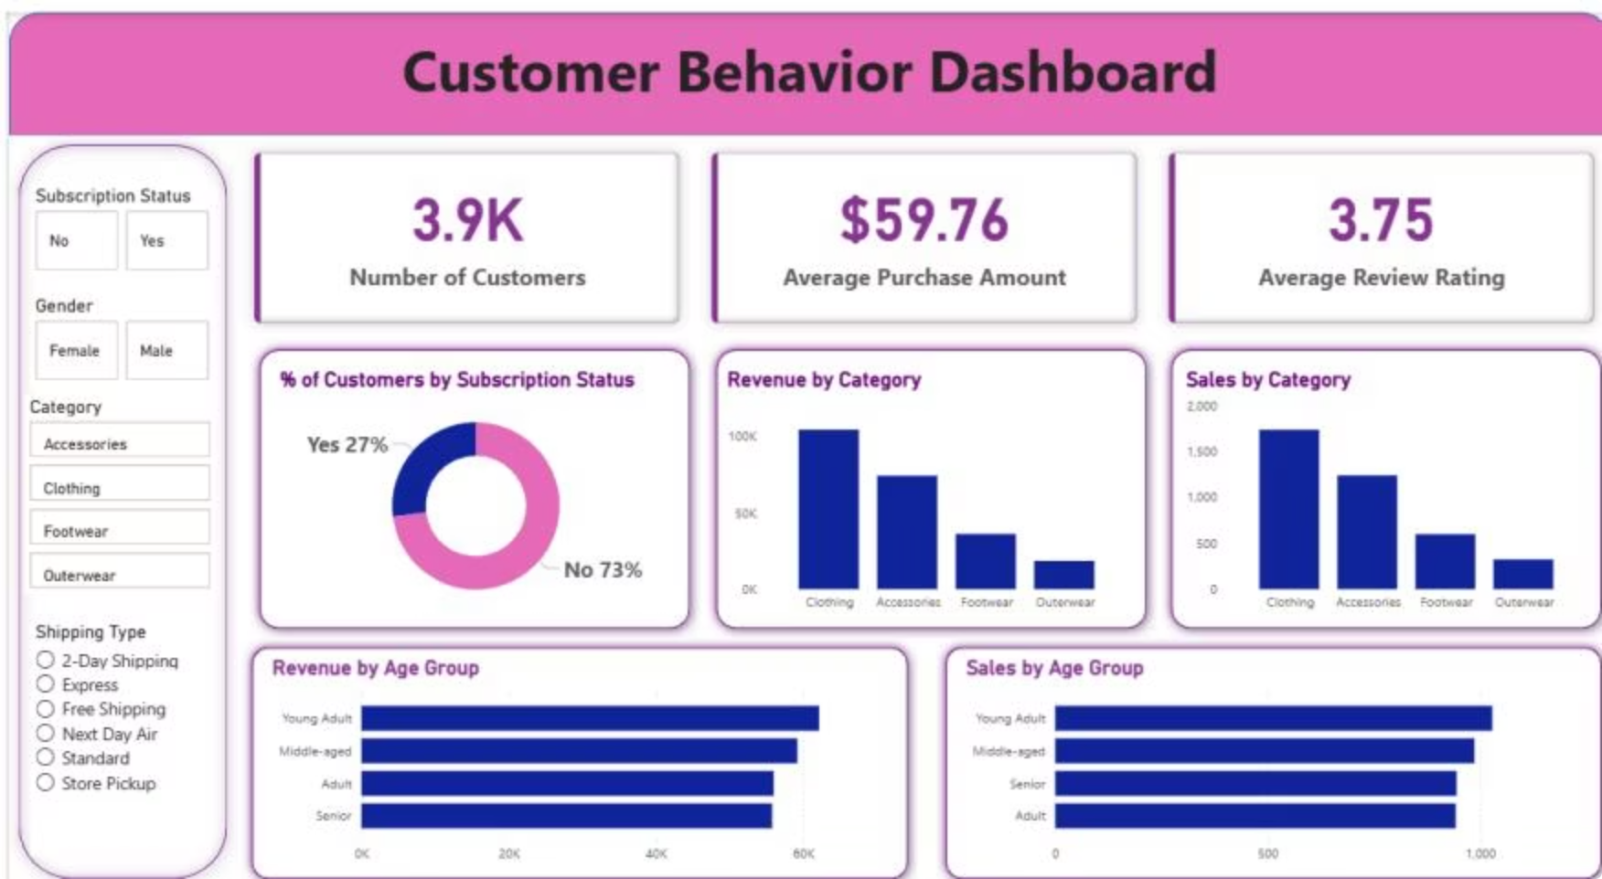
Interactive Dashboard
Power BI dashboard visualizes customer behavior across subscription status, demographics, and product categories—enabling real-time insights into revenue patterns and customer segments.

Slide 8


Strategic Recommendations
Boost Subscriptions
Promote exclusive benefits to convert loyal repeat buyers into subscribers
Loyalty Programs
Reward repeat buyers to strengthen the 80% loyal customer segment
Review Discounts
Balance promotional sales with margin control on high-discount products
Targeted Marketing
Focus on high-revenue age groups and express shipping users for maximum ROI

